Slide 1
Engineering Analysis
(applied)
MEE 460 01
Project 2
Giacomo Flora, Ph.D.
April 2nd, 2024

Slide 2
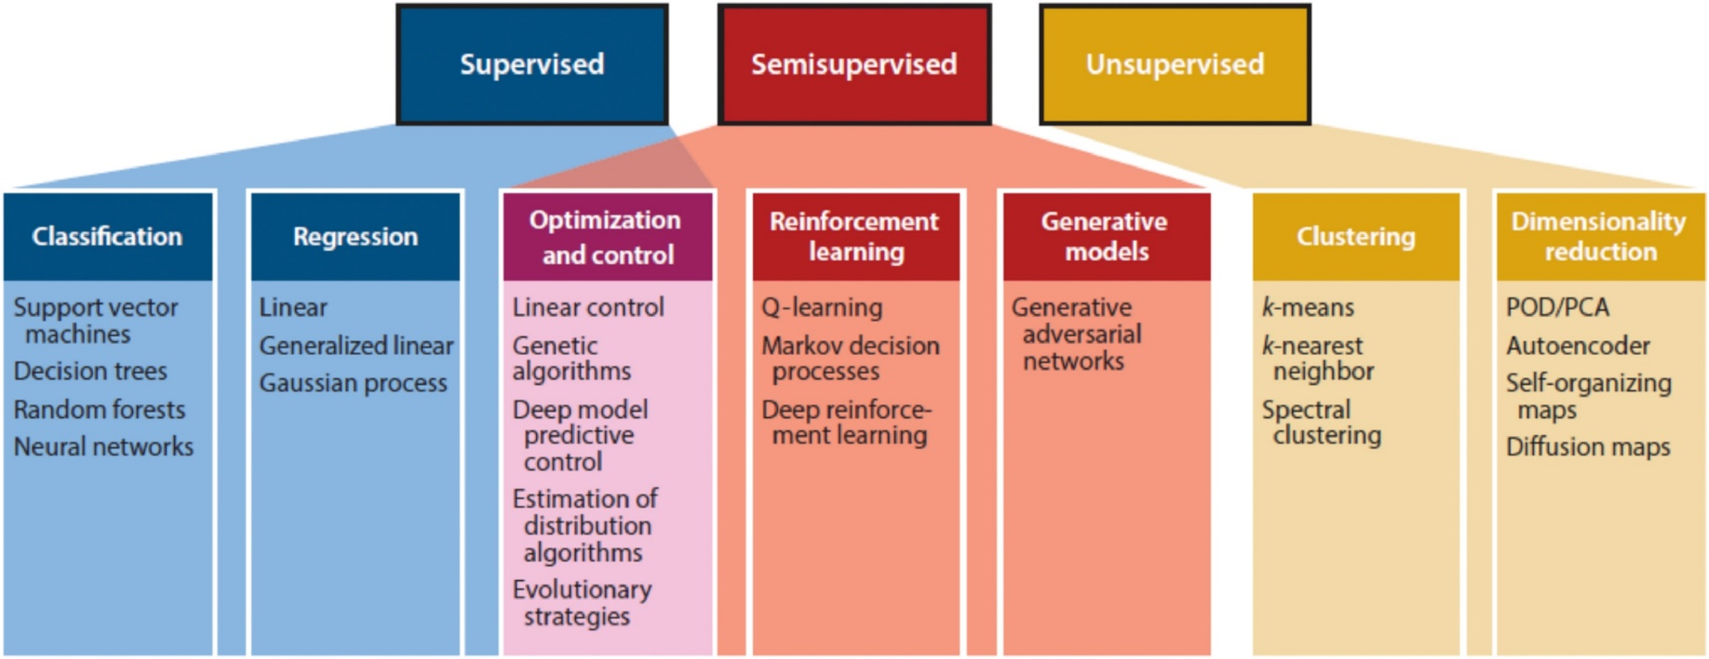
Machine Learning
Supervised vs Unsupervised
Supervised: very well defined features and targets
Unsupervised: Not defined features and targets
L. Zhou, Y. Song, W. Ji, and H. Wei, “Machine learning for combustion,” Energy and AI, vol. 7, p. 100128, Jan. 2022.

Slide 3
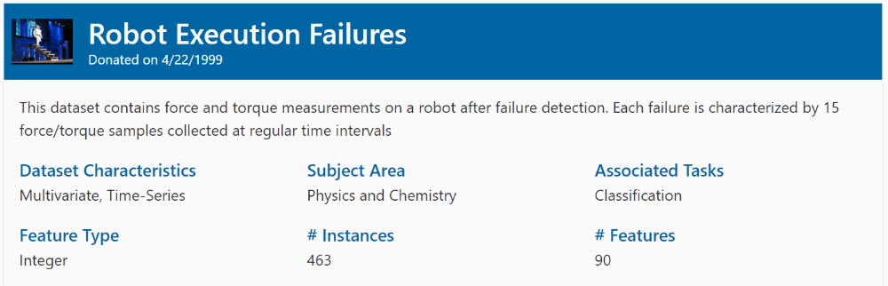
Robot Failure
https://archive.ics.uci.edu/dataset/138/robot+execution+failures

